Slide 1


HTML & CSS: FUNDAMENTALS OF DEVELOPMENT
Instructor: Beck Johnson Week 2

Slide 2

SESSION OVERVIEW
Week One review and questions
File organization
Version control and code sharing with Git
Background images and gradients with CSS
How to FTP (put your website online)

Slide 3

REVIEW!

Slide 4



REVIEW: WEBPAGE COMPONENTS
html
Structures and organizes content
css
Styles the markup and creates layout
Javascript
Brings content and design to life

Slide 5
REVIEW: HTML DOCUMENTS
<!DOCTYPE html> tells the browser it's serving an HTML file using HTML5 standards
<html> wraps the whole document
<head> wraps the metadata and styles
<body> wraps the visible content
Most HTML elements have opening and closing tags and some have attributes

Slide 6
REVIEW: layout elements
<header> wraps header content
<footer> wraps footer content
<nav> indicates that everything inside is related to navigation
<section> is used to define content sections

Slide 7
REVIEW: HTML CONTENT
Headings create an header/outline
<h1>...<h6>
Paragraphs and lists structure text
<p>
<ul>
<ol>
Images and links both require attributes to work

Slide 8
Review: IMAGES
<img src="kitten.jpg" alt="Cute kitten" />
Does not have a closing tag (“self-closing”)
Two required attributes:
src is where the file lives (local or external)
alt is a description of the image (used for screen readers, search engines, etc.)

Slide 9
Review: Links
<a href="http://google.com">Google</a>
Creates a link to other pages or websites
The href attribute says where the link should go
Anything inside <a> tags is clickable

Slide 10
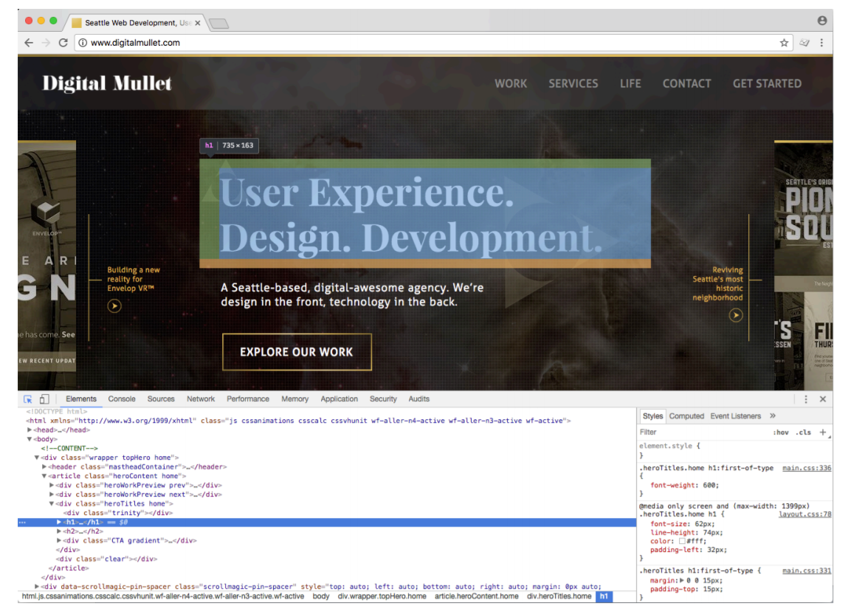
Review: Dev tools
Right-click > Inspect, or hit the F12 key

Slide 11
REVIEW: Css
CSS (Cascading Style Sheet) is a different type of language than HTML, and has its own syntax
CSS can go directly in your HTML file, inside a <style></style> element
CSS can be added in a separate .css file that can be linked to your HTML page

Slide 12
REVIEW: EXAMPLE CSS RULE
p { color: blue; }
selector is p (all <p> tags in the HTML)
property is color
value is blue (many color names are supported, or use the hex code #0000ff)

Slide 13
QUESTIONS?

Slide 14

FILE ORGANIZATION

Slide 15
FILE ORGANIZATION
If you structure your site correctly, you are one step closer to faster updates
Structure should be not just for you, but for anyone who might use, need or want any of your files (images, scripts, stylesheets, etc)
The next person to work on or look at your code will be able to understand what you’ve done and where to find things

Slide 16
FILE ORGANIZATION
Typical files in a website include:
HTML files (.html)
CSS files (.css)
Javascript files (.js)
Images (.png, .jpg, .gif)
HTML should usually go in the main (root) directory
Make subdirectories for media, CSS, and Javascript files

Slide 17
FILE Naming RULES
Use a consistent naming convention when naming files and folders
For example, always all lowercase, or words always separated by dashes, etc
Capitalization matters
INDEX.html is not the same as index.html
Use only letters, numbers, hyphens (-) or underscores (_)
No spaces in file names

Slide 18
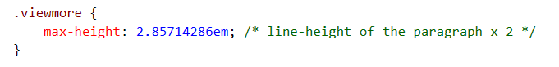
Code organization
Comment your files – especially if you have unfinished development code, or if you think you may forget why you made the decision you did
Indent your code (trust me)

Slide 19
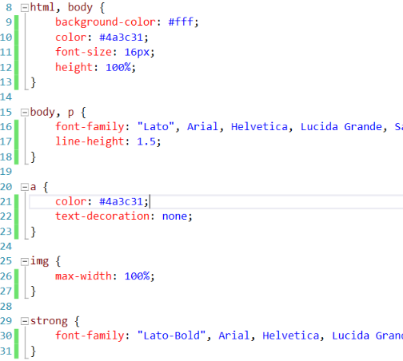
css indentation
This is one popular way to indent CSS
Starting bracket is on the same line as the selector
Each property is on its own line, tabbed once
Ending bracket is on its own line

Slide 20
PRACTICE TIME!

Slide 21
assignment
Create a folder for your images and move all images there
Fix the paths in all your <img src> tags so that images show like before
Remember the different between relative and absolute paths
Prettify your CSS and HTML so that it’s easy to read
Use indentation and whitespace

Slide 22


Slide 23
{ } states in CSS
CSS also allows you to apply styles based on the state of an element
Being hovered over with a mouse
Gaining focus via tabbing or clicking
This is known as a CSS pseudo-class (because it doesn’t really exist)
Whenever you see a : in a selector, that style will only apply to elements that are in that state

Slide 24
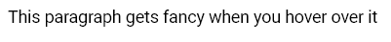
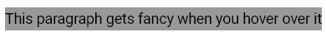

{ } Pseudo ex-psample
p:hover { background-color: #999; }

Slide 25

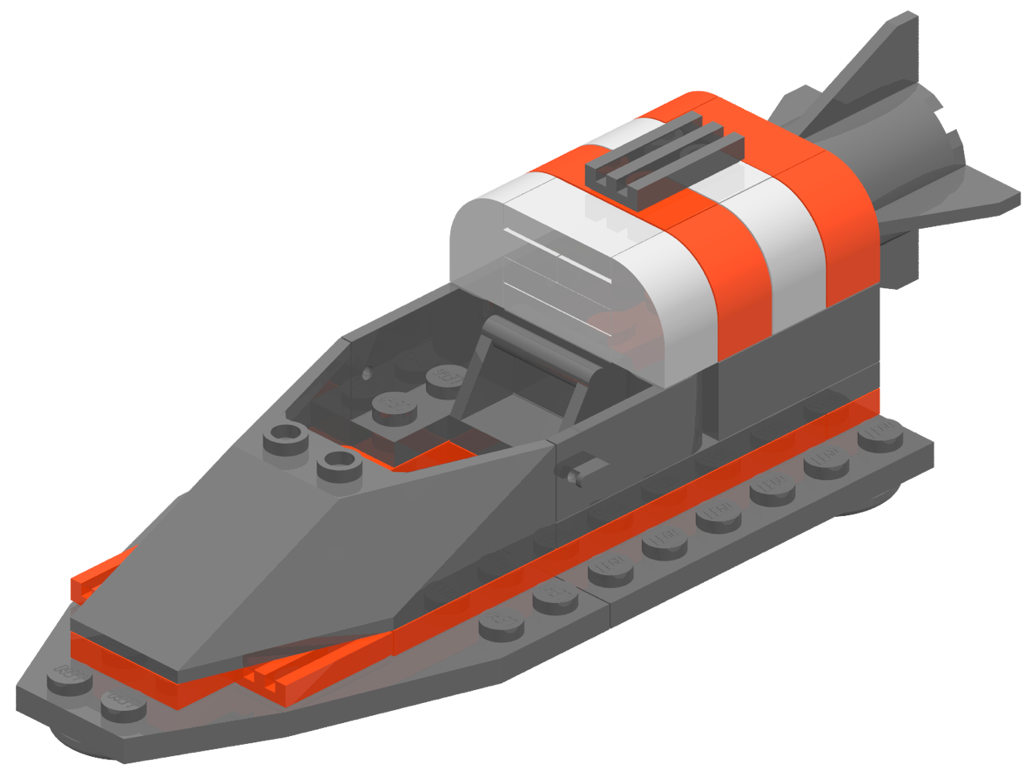


{ } link states
Links have two additional states
:visited only applies once the user has viewed the page that is being linked to
:link only applies to unvisited pages
a:link
a:visited
a:hover
a:active

Slide 26
{ } four link states
a { color: blue; }
a:visited { color: gray; }
a:hover {color: purple; }
a:active { color: yellow; }
Let’s inspect a live demo of how this looks

Slide 27
{} CSS in multiple places
So far, we’ve been making CSS changes directly on a single webpage, in the <head> element.
These internal styles only apply to that page (but affect every element on that page that is styled)

Slide 28
{} CSS in multiple places
You can also add inline styles to a single element by using the style attribute in HTML markup
<p style="color: red">This paragraph is special.</p>
Inside the style attribute, use the same syntax as CSS (selector: value)
Typically discouraged, because it can be hard to maintain

Slide 29
{} CSS IN MULTIPLE PLACES
The most common way to use CSS in the “real world” is to use an external stylesheet.
CSS lives in a separate .css file
The same stylesheet can be included on multiple pages
A single page can include multiple stylesheets

Slide 30
{} Linking to external stylesheet
<link href="css/styles.css" rel="stylesheet">
Tells the browser to find and load the styles.css file from the css directory
The rel attribute stands for "relation" - in this case, this link's relationship to the document is "stylesheet"
This tag goes inside the <head> element
Should be on every page that needs the styles

Slide 31
{} The “CASCADING” Part
The beauty of CSS is being able to create styles and then override them when you want to customize the look of your pages.
There are 3 rules for determining how styles get applied:
Styles are applied from far to near
Styles are applied from top to bottom
Children elements are more specific than parents

Slide 32
{} far to near
Styles that are “closer” to the elements they style take precedence.
Browser default
External style (from a .css file)
Internal style (from styles in the <head>)
Inline styles (directly on the element)

Slide 33
{} Top to bottom
CSS rules are applied sequentially
If the same property is styled multiple times for the same selector, the last one wins
p | { | color: | #2f4251; | }
p | { | color: | #daa645; | } | /* | this | one | wins | */

Slide 34
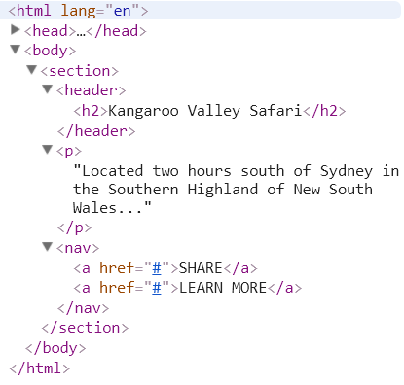
{} HTML children
In an HTML document, an element that is nested inside another element is referred to as a “child” of that element
<h2> is a child of <header>
<a> are children of <nav>
Both <a> and <h2> are also children of <section>

Slide 35
{} HTML children
In CSS, to style only elements that are inside another element, use this syntax:
parent child { property: value; }
nav a { color: #c4fe46; }
“Change the color of links that are
contained within a nav”

Slide 36
{} Children are specific
Children elements inherit styles from their parents, but can override with their own style
p { color: #daa645; } /* all paragraphs */
b { color: #e7c0c8; } /* bold text in general */
p b { color: #c4fe46; } /* bold text in paragraphs */

Slide 37
PRACTICE TIME!

Slide 38
{ } External Stylesheets
Create a folder for css, then create a new file in that folder called styles.css
Copy and paste the styles from inside <style></style> into that .css file, then delete the <style></style> tag
Create a link to your new stylesheet on all of your webpages:
<link href="css/styles.css" rel="stylesheet">
Does everything still look the same?
Make a style change that only affects a child element, for example:
Only links inside a footer, header, or navigation element
A list that’s inside another list

Slide 39

Version control

Slide 40




Version control
In modern development, most websites are a team effort.
Version control systems (VCS) allow multiple people to work on the same file with less risk of overriding changes.

Slide 41
git
is a free, open-source version-control system
Git is software that tracks any changes that you (or anyone else) make to a project
A project contains every file and subdirectory inside a folder
The “master copy” of the project is stored on a remote server
You can download a copy of the project from the server, create new versions of the project, and also have access to every version (of every file!) saved along the way

Slide 42
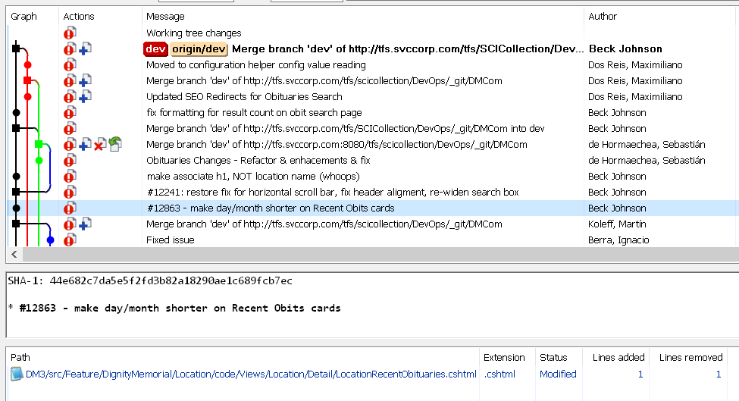
git
When you upload changes to the remove server, you can add a friendly message indicating what you changed:

Slide 43

github
GitHub.com is a free online hosting provider for code that is tracked using Git
Code is stored publicly (unless you want to pay extra)
Very popular storage place for open-source projects
The website for this class is hosted by GitHub!

Slide 44

BACKGROUND images

Slide 45
BACKGROUND COLOR review
p {
background-color: gray;
color: white;
}
This is a paragraph with the background color set to gray.

Slide 46
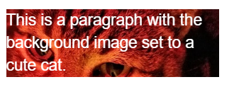
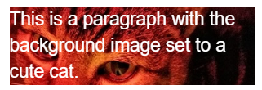
BACKGROUND IMAGES
Can set background of an element as an image (instead of a color) with the property background-image
The value is url("path"), where path is the relative or absolute path to where the image lives, like this:
p {
background-image: url("images/kitten.jpg");
color: white;
}

Slide 47
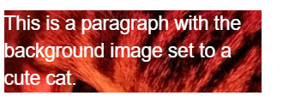
BACKGROUND IMAGES
p {
background-image: url("images/kitten.jpg");
color: white;
}
The amount of image that displays in the background is calculated based on image size and container size.
Make sure to resize images so that the part you want visible is within the “view window”
Or…

Slide 48

BACKGROUND POSITION EXAMPLES
background-position: allows you to move a background image around within its container
By default, an image is positioned at the top left side of the container
section {
background-image: url("octopus.jpg");
background-position: top left;
}
Image width: 600px by 800px

Slide 49
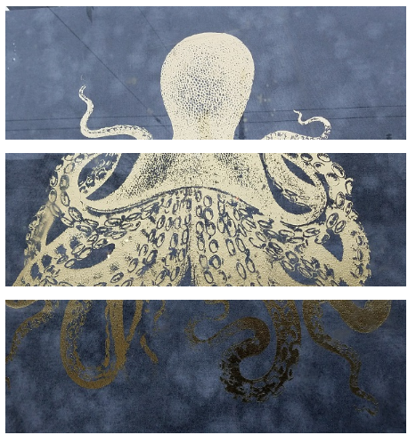
BACKGROUND POSITION EXAMPLES
Container width: 600px by 200px
background-position: top left;
background-position: center center;
background-position: bottom right;

Slide 50
BACKGROUND repeat
background-repeat: defines if (and how) the background image will repeat
By default, background images are repeated until they fill the entire container
p {
background-image: url("codepen.gif");
background-repeat: repeat;
}

Slide 51




BACKGROUND repeat
repeat: tile the image in both directions
repeat-x: tile the image horizontally
repeat-y: tile the image vertically
no-repeat: don't repeat, just show the
image once

Slide 52
BACKGROUND attachment
background-attachment: images usually scroll with the main view, but setting to fixed means the image stays in place when the user scrolls the page
Difficult to describe, so check out this demo or this demo
section {
background-image: url("pattern.png");
background-attachment: fixed;
}

Slide 53
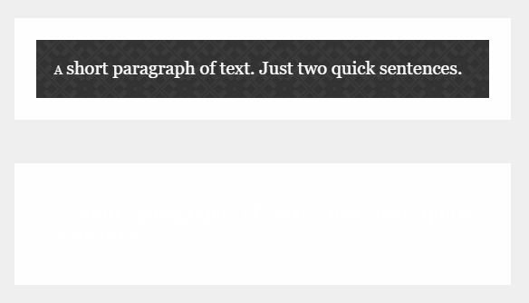
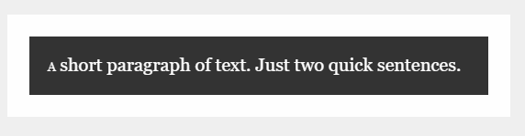
Fallback BACKGROUND color
If your background image is dark and your text is light
You may want to specify a background-color in addition to a background-image so that content is visible while the image is loading
So instead of a “blank” area…
…the user can see content while the image downloads

Slide 54


Background gradients
You can set background-image to linear-gradient, which is a gradient that the browser draws for you:
section { background: linear-gradient(black, white); }
As many colors as you want can be blended, separated by commas:
section {
background: linear-gradient(#ea992e, red, #9e5308);
}

Slide 55


Background gradients
By default linear-gradient draws from top to bottom, but you can set the gradient to draw at an angle instead by starting with to
section { background: linear-gradient(to bottom right, black, white); }
section {
background: linear-gradient(to right, red, #f06d06, yellow, green);
}

Slide 56

Background gradients
Background gradients can use rgba colors, meaning you can create a gradient that fades to transparent:
body {
background-image: url("flowers.png");
}
header {
background-image: linear-gradient(to right, rgba(255,255,255,0), rgba(255,255,255,1));
}

Slide 57
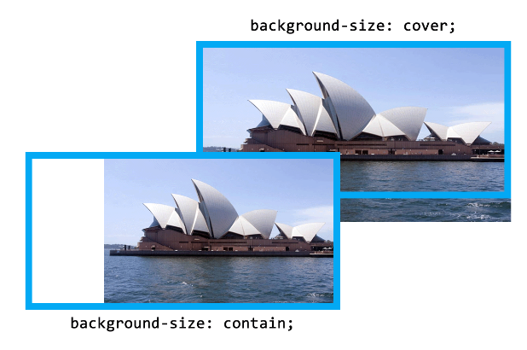
BACKGROUND size
background-size: specifies how much of the container that the image covers
cover: always cover the entire container (even if that means cropping an edge, or making the image bigger)
contain: always show the whole image (even if that means there is space on the sides or bottom)

Slide 58
Height and width
To ensure that a background image fully displays, you can set the height (and/or width) attribute on the element using CSS:
header {
background-image: url("images/hero.png");
height: 600px;
}

Slide 59
Height and width
height and width can be set on (most) elements to change how much room they take up on the page.
We’ll discuss later why elements like <a> and <em> don’t change when you set their height or width
The value of this property must be a positive number.
Units are either px or em
Or you can specify a percentage
header { height: 6em; }

Slide 60
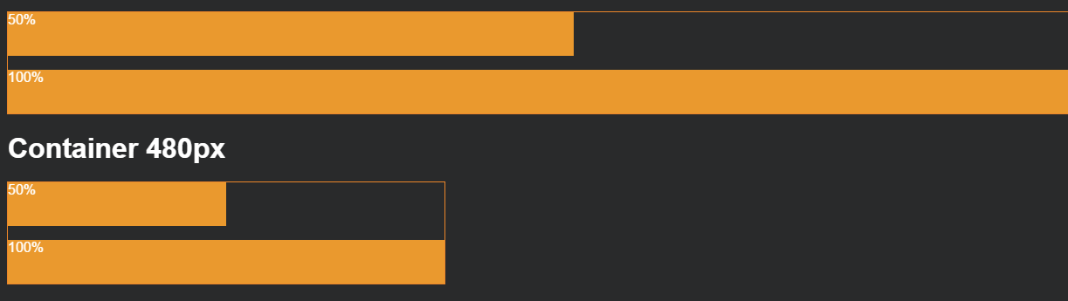
Height and width %
Percentage is based on the element’s parent’s width or height
section { width: 50%; }
If that section were inside a 480 px wide container, it would end up being 240 px wide.

Slide 61
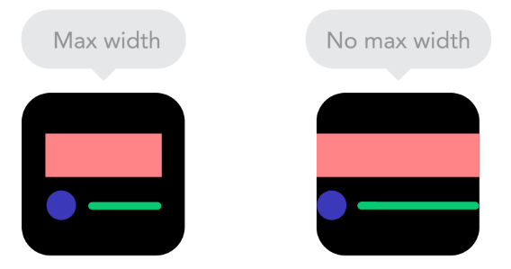
Max-Height and max-width
To ensure an element is never larger than a certain value, use max-height or max-width
Typically used to make sure content (particularly text) doesn’t spread too far out on large monitors

Slide 62
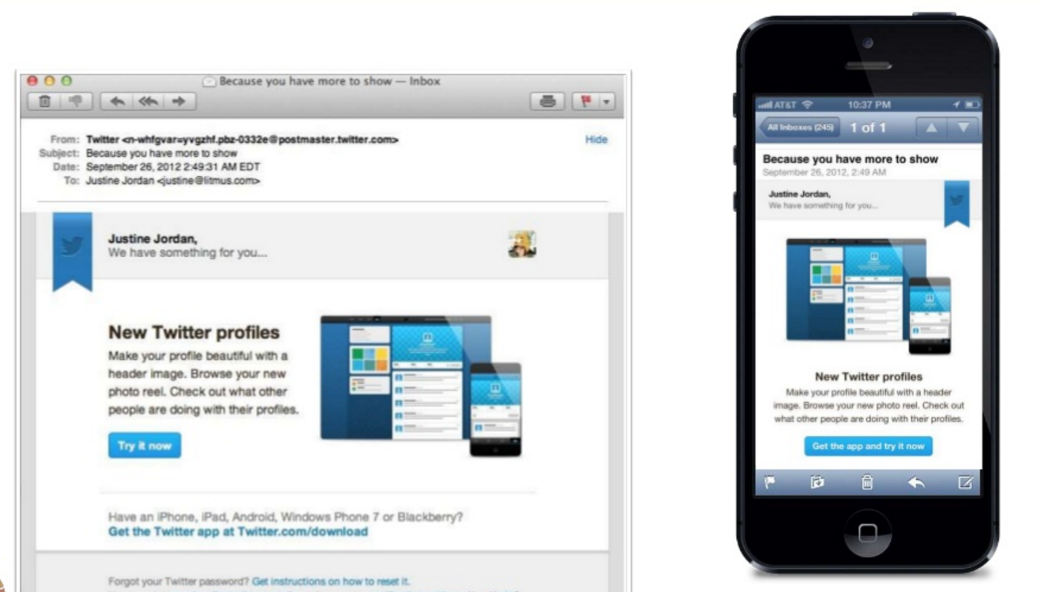
Min-Height and min-width
Specify min-height or min-width if you want to ensure an element is never smaller than a certain value.
This is especially helpful if your size is “dynamic” (based on percentage) and will vary depending on device
img {
width: 50%;
min-width: 350px;
}

Slide 63
Min-maxing
height and width fix an element to a specific size regardless of display size
If width is wider than the display – scroll bars
If width is smaller than the display – content may wrap even if there is room
min-height, min-width, min-height, and min-width allow elements to change when the display size changes, but still allow some control over presentation.

Slide 64
Min-maxing
You can choose to set only width and/or height, only min-width/min-height, and only max-width/max-height – or any or all of them, depending on your design.
For example, this section will expand up to 500 px wide, and then get no bigger. If you shrink your browser, it will shrink until its 100 px wide, and then get no smaller.
section {
min-width: 100px;
max-width: 500px;
}

Slide 65

Not all heroes wear capes
A common use of background-image is to create a “hero” image with text overlaying it

Slide 66
PRACTICE TIME!

Slide 67
Make a hero
Add a “hero image” to your site.
Play around with a bunch of the background properties we learned to make your hero look pretty
Try setting a width and height. What happens when you resize your browser window? Change to min-width – what changes?

Slide 68
DOMAINS & WEB HOSTING

Slide 69
PRACTICE, STUDY, PRACTICE
Domains & hosting
What is a domain name?
The Domain Name System, or DNS, is like a phone book for the internet
It’s essentially a list that maps the location of files on a server (identified by a series of unique numbers called an IP Address) to a friendly name, like Wikipedia.org

Slide 70
PRACTICE, STUDY, PRACTICE
Domains & hosting
How do I buy a domain name?
Companies called registrars manage the reservation of domain names
GoDaddy is one of the largest registrars, but many smaller companies also provide this service
ICANN is the agency responsible for regulating and accrediting registrars

Slide 71
PRACTICE, STUDY, PRACTICE
Domains & hosting
I bought a domain name…
now what?
Registering a domain name maps that name to a location where the files will be hosted, but does NOT necessarily provide server space for your files
GoDaddy will both register and host your website, as will many other companies
You can buy a domain name from one company and host your files at another (or, host from a computer you own!)

Slide 72

PRACTICE, STUDY, PRACTICE
Domains & hosting
A common way to upload your website is using FTP (File Transfer Protocol).
You don’t have to understand it, just find an FTP client you like and copy your files using the program.
Filezilla
Cyberduck

Slide 73

“HOMEWORK”
Practice!
Optional: read chapters 10-12 and chapter 16 of HTML and CSS: Design and Build Websites
Check out the CSS Zen Garden for inspiration on how simply changing CSS can change the entire look and feel of a page

